Slide 1
PRMS Calibration with Luca

Slide 2
PRMS Calibration with Luca
Multiple-Objective Stepwise Calibration
PRMS IV Manual:
Appendix 3. PRMS-IV Merced River Example Application
Merced River Basin, California
517 km² in area and ranges in elevation from 1200-3320 meters.

Slide 3
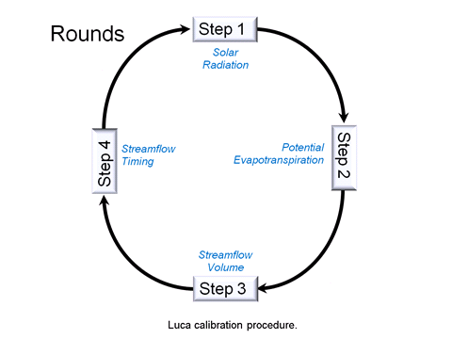
Multiple-Objective Stepwise Calibration

Slide 4
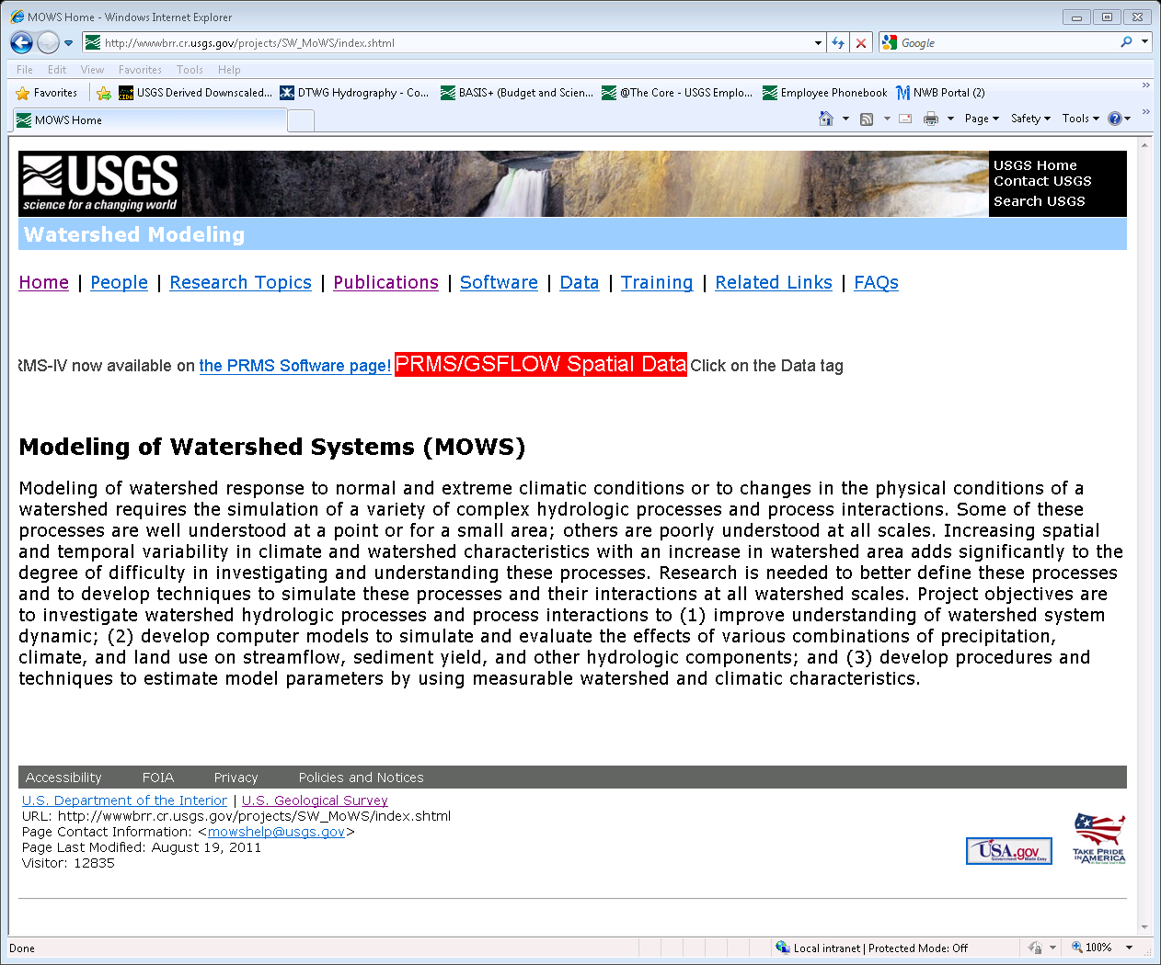

Slide 5
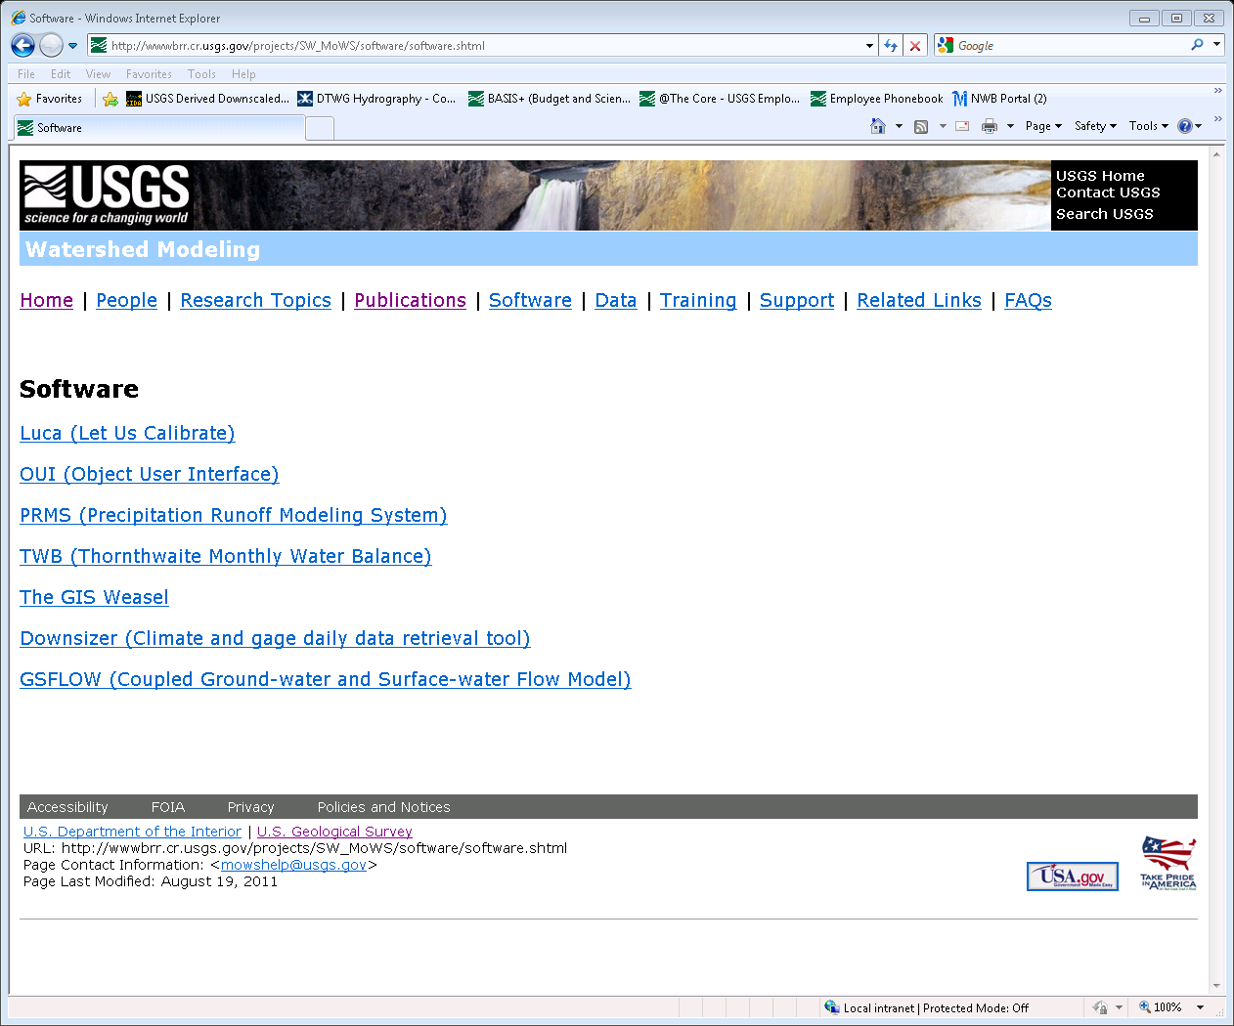

Slide 6
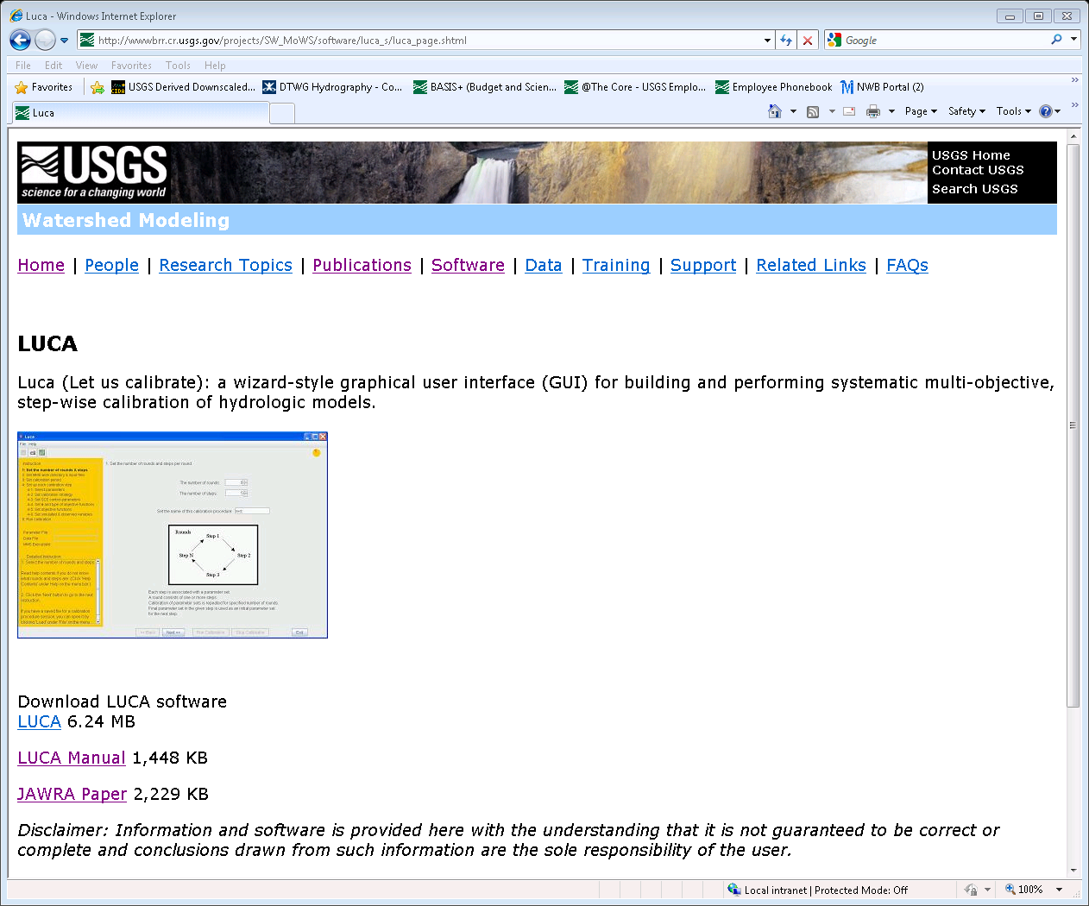

Slide 7
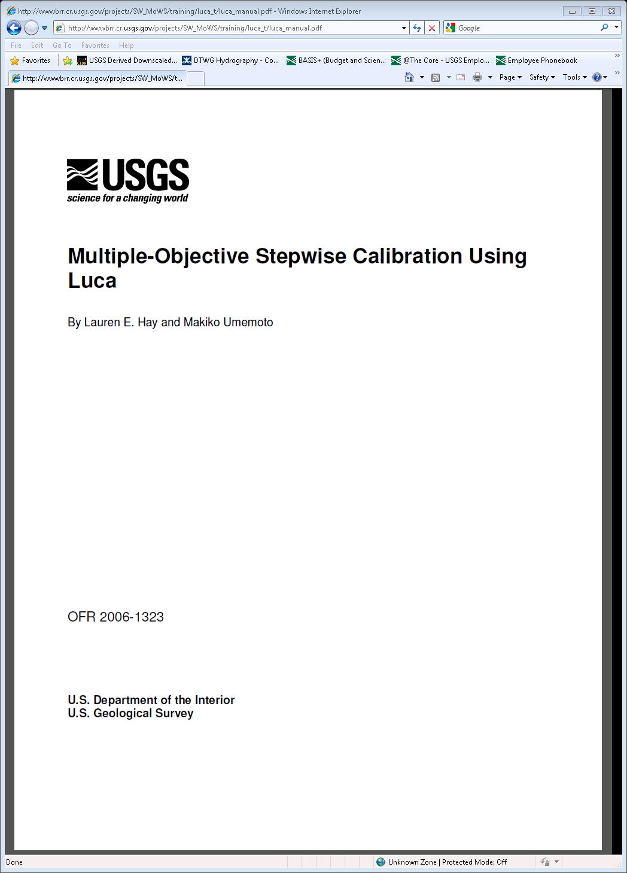

Slide 8
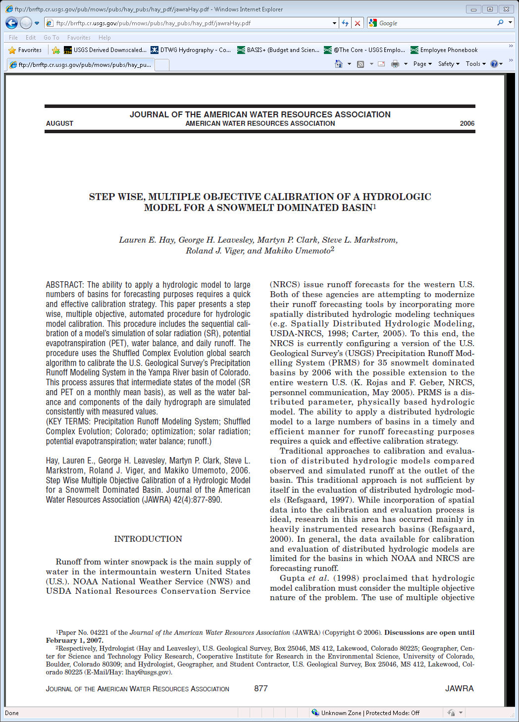

Slide 9
PRMS Calibration with Luca
Multiple-Objective Stepwise Calibration
PRMS IV Manual:
Appendix 3. PRMS-IV Merced River Example Application
Merced River Basin, California
517 km² in area and ranges in elevation from 1200-3320 meters.

Slide 10
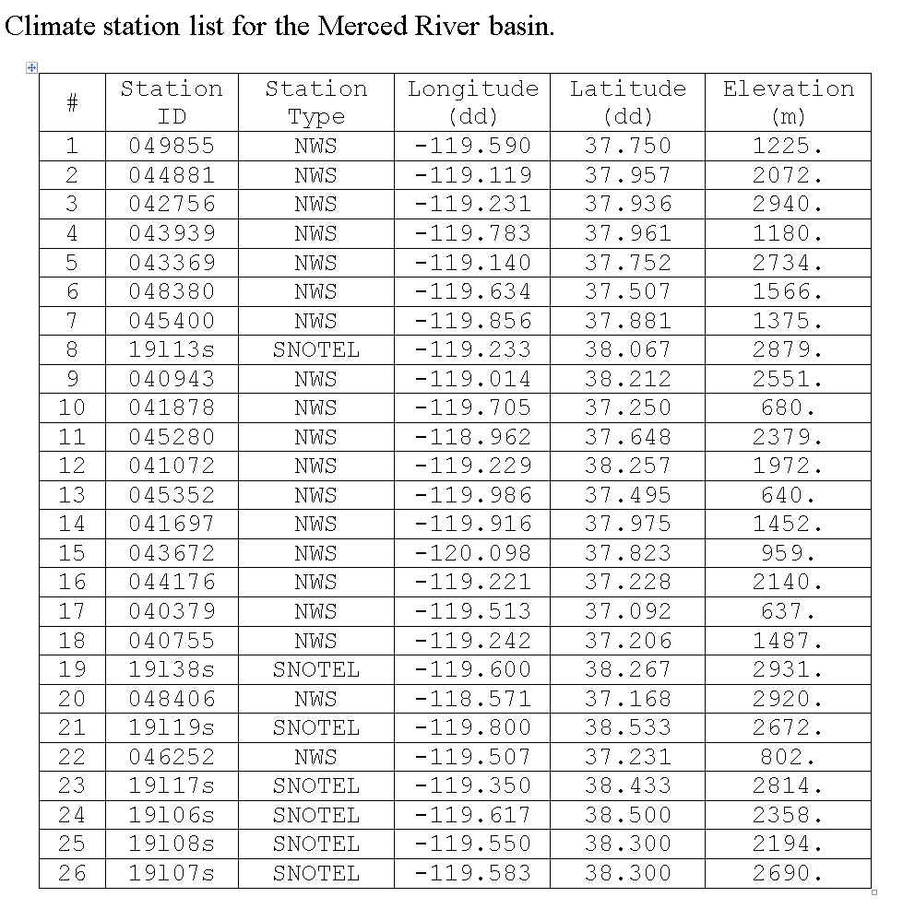
Using XYZ (xyz_dist module) to distribute precipitation and temperature
→ Get climate stations

Slide 11
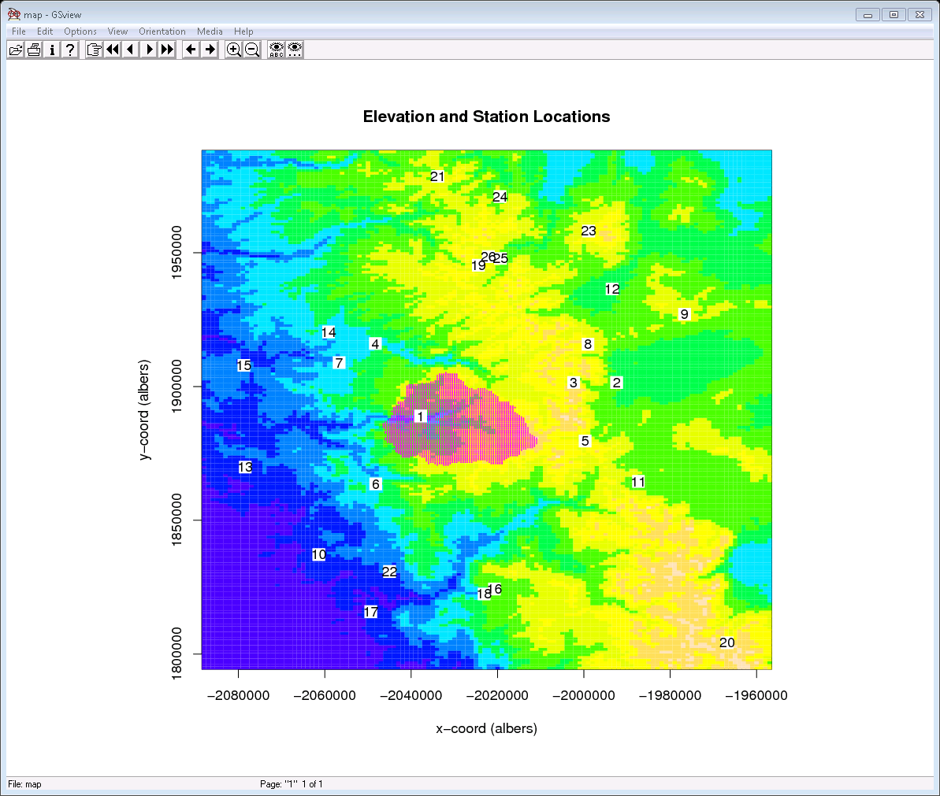
Merced River Basin, California
517 km² in area and ranges in elevation from 1200-3320 meters.

Slide 12
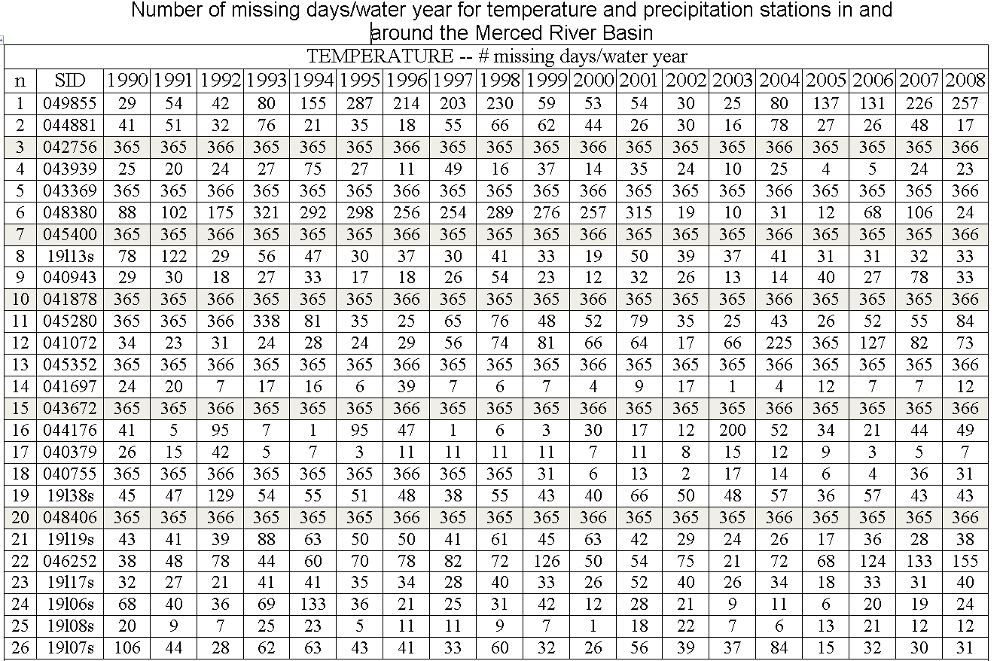

Slide 13
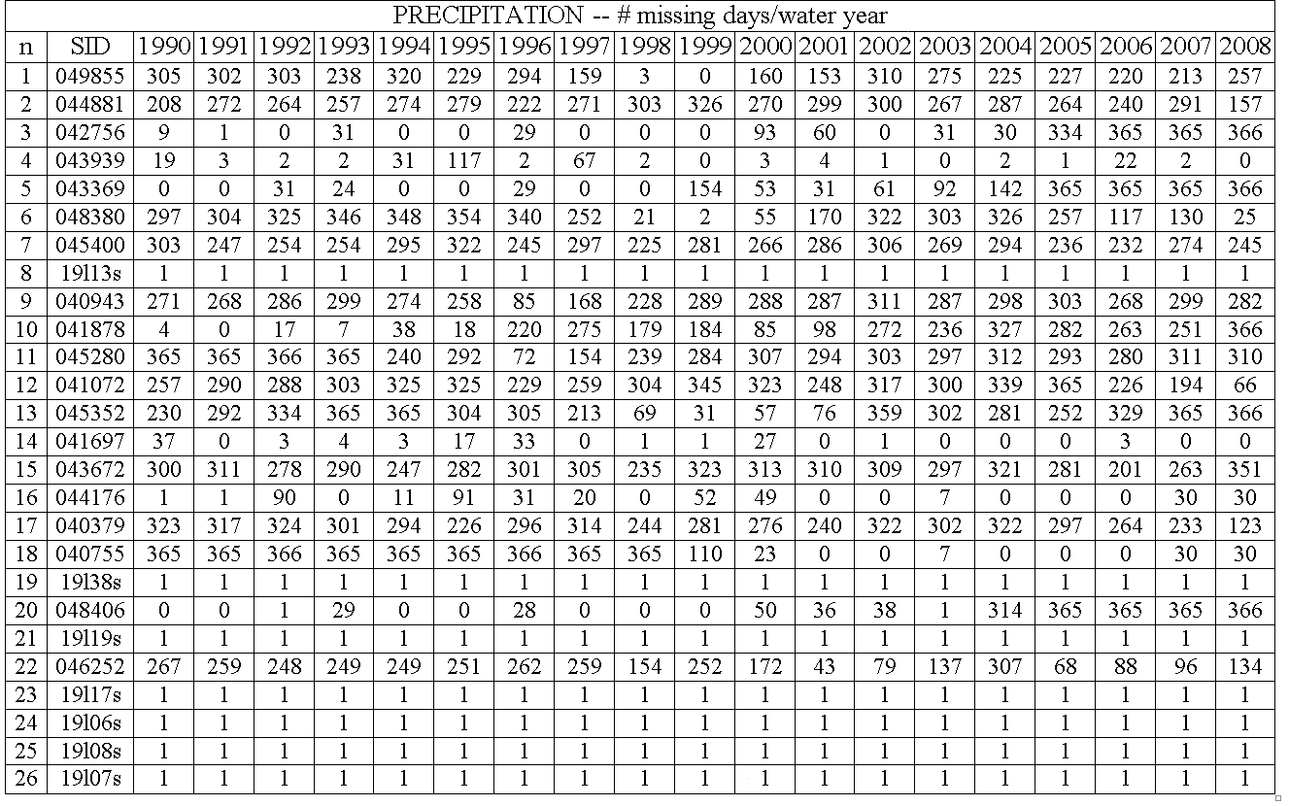

Slide 14
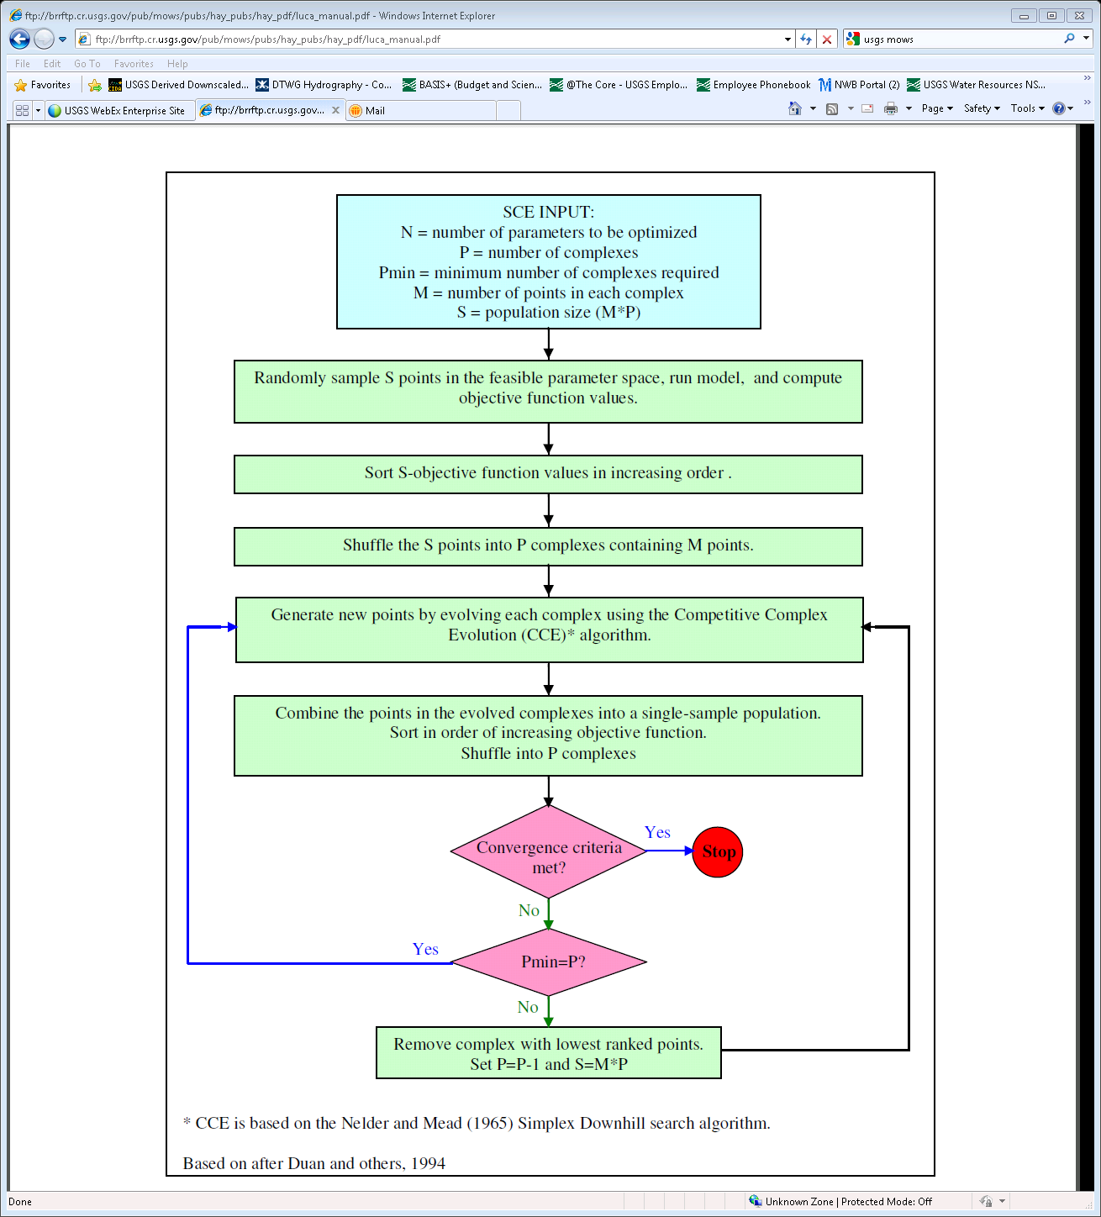
Shuffled Complex Evolution (SCE) approach for global optimization

Slide 15
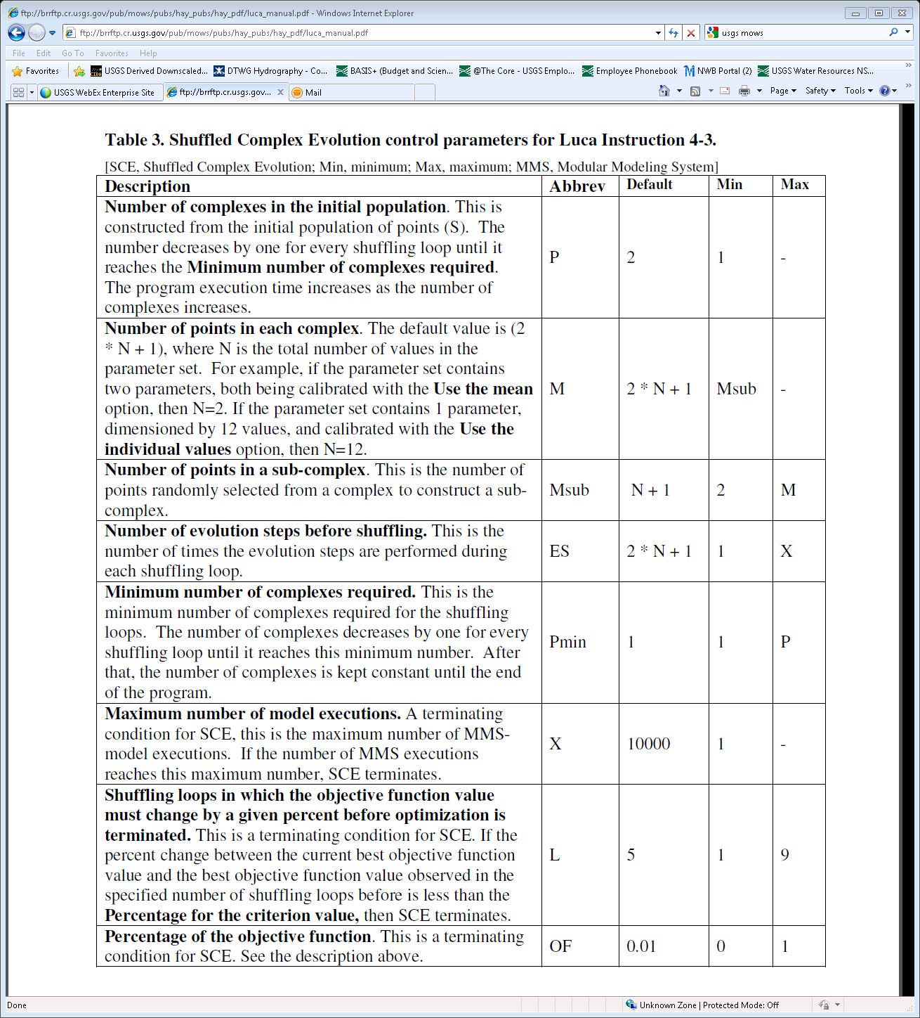

Slide 16
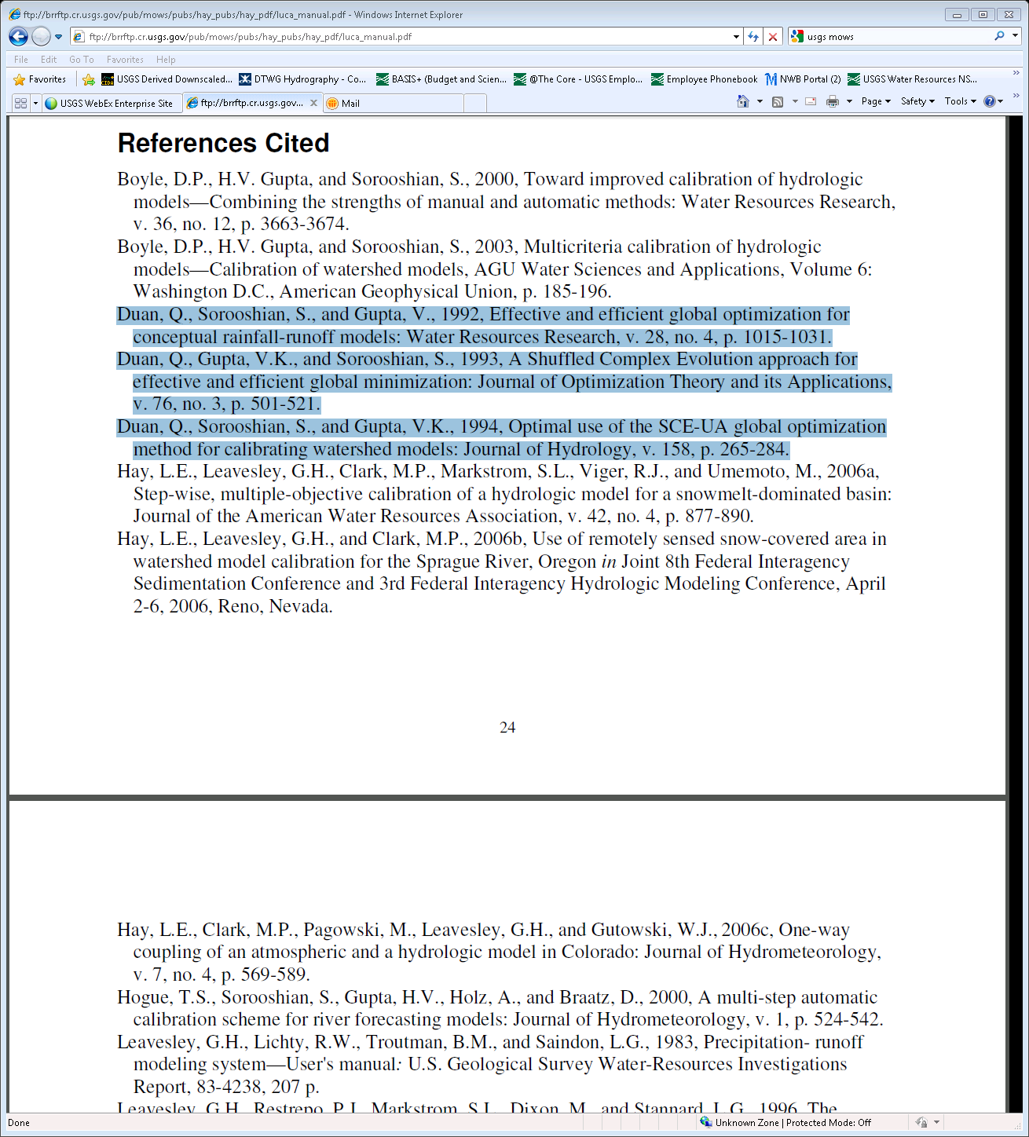

Slide 17
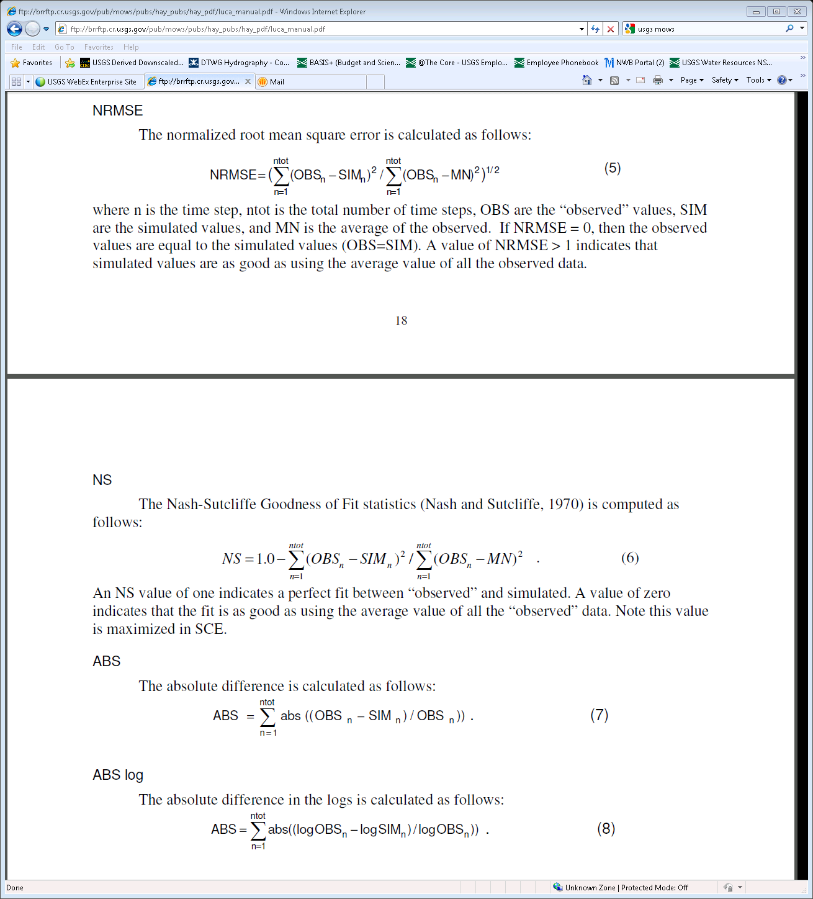
Choice of Objective Functions:

Slide 18
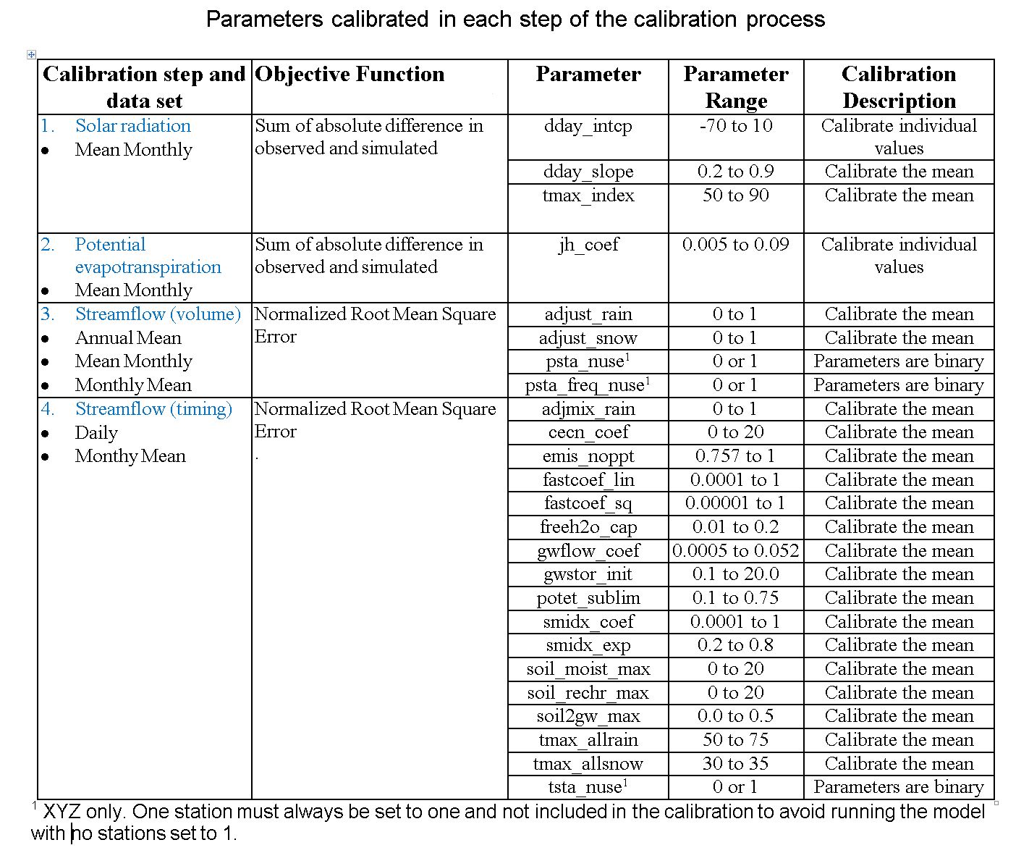

Slide 19
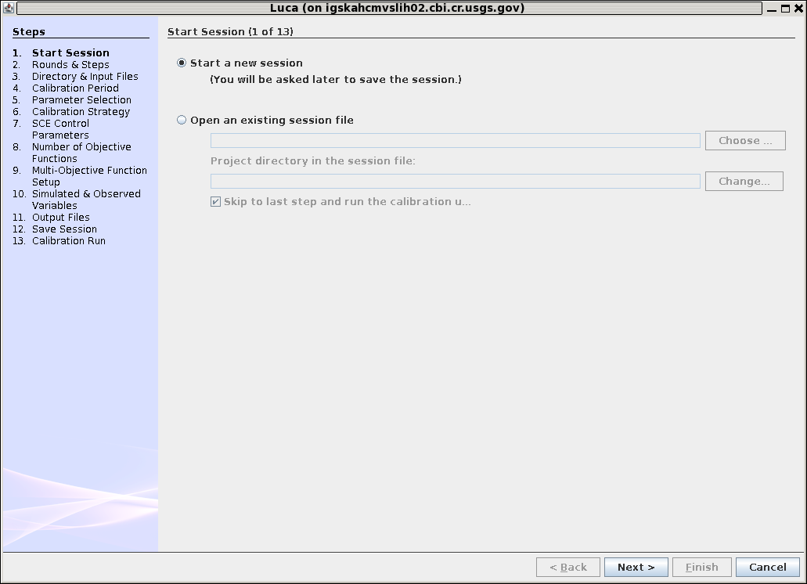
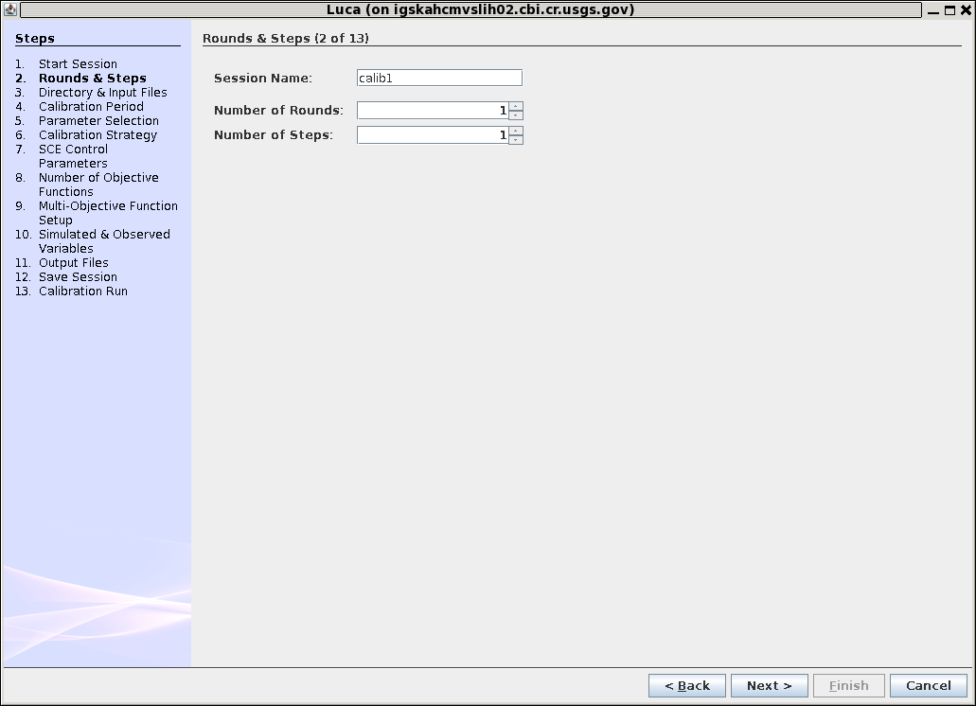
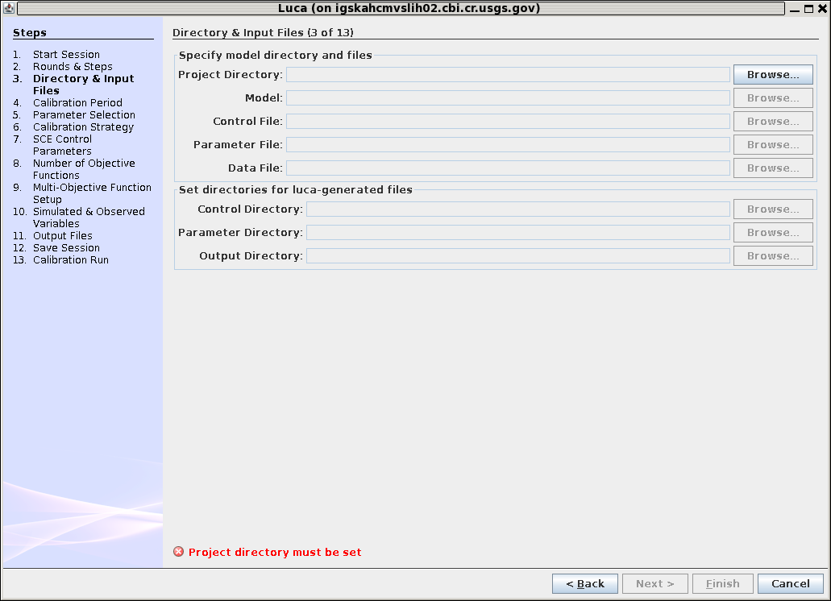
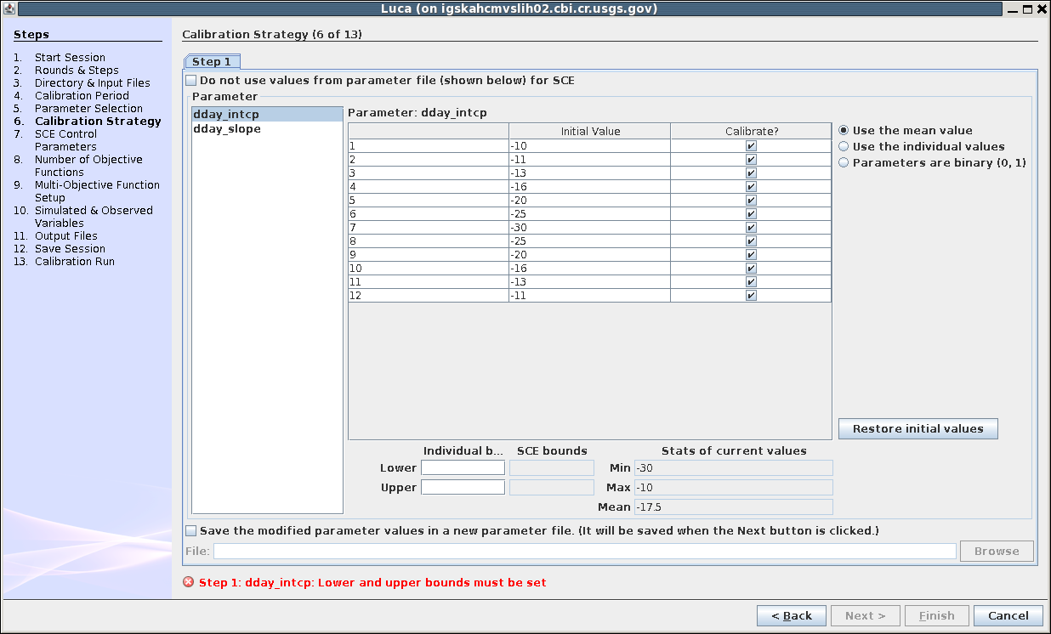
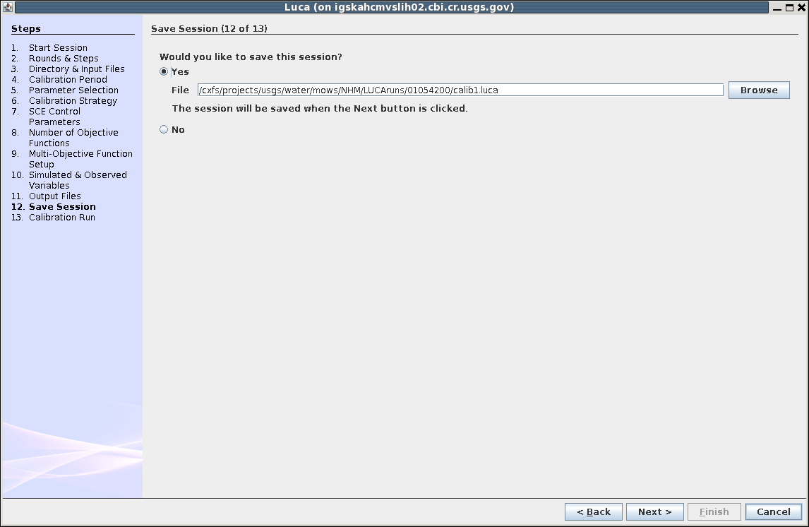
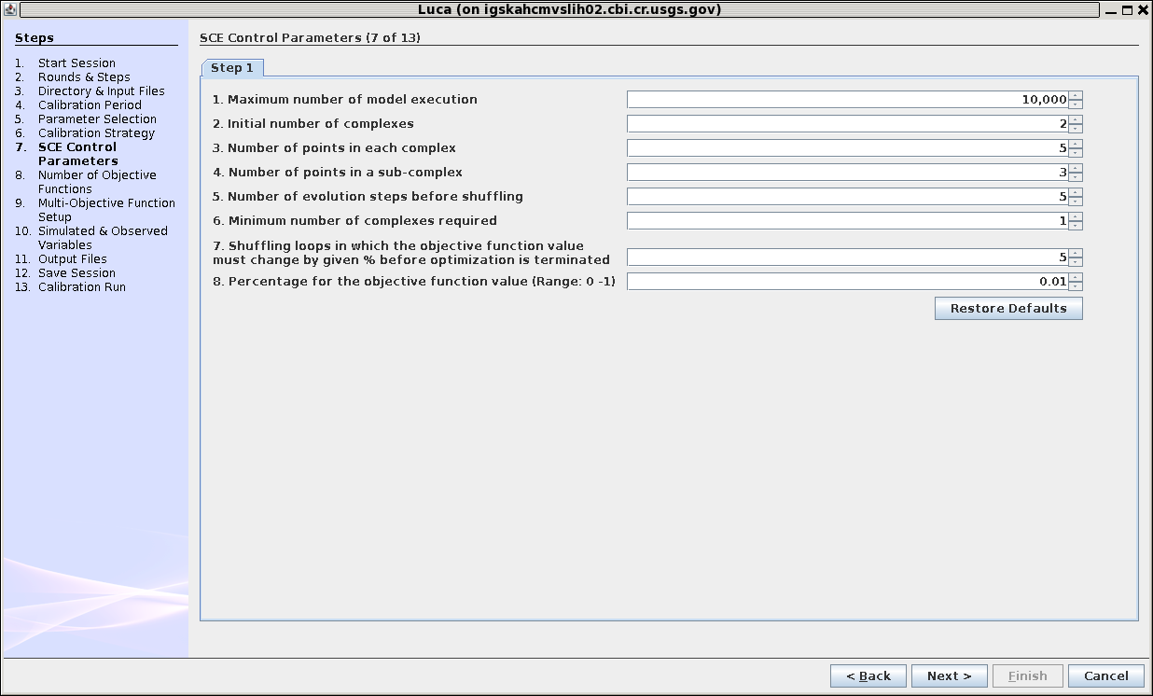
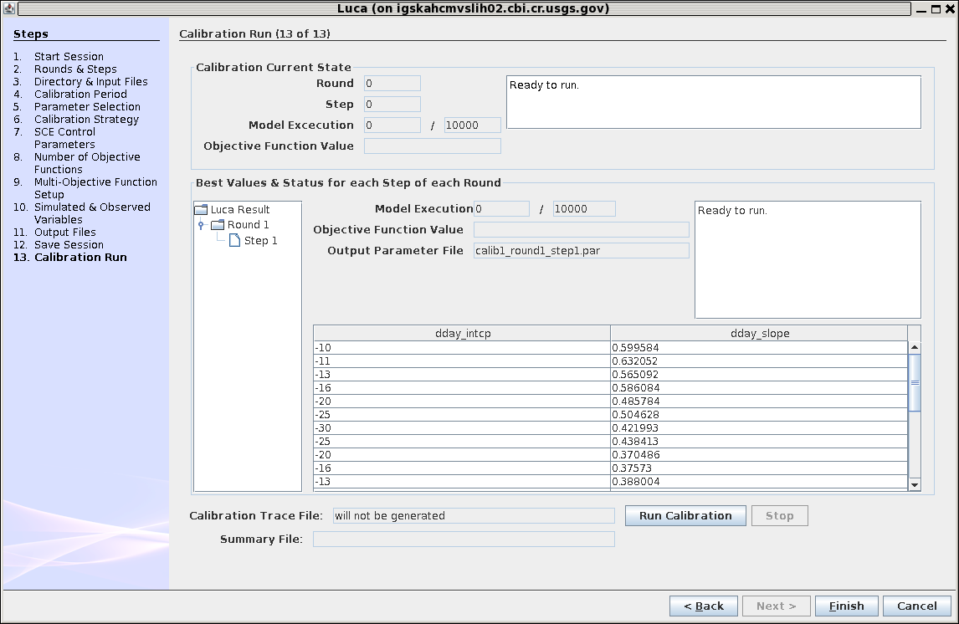
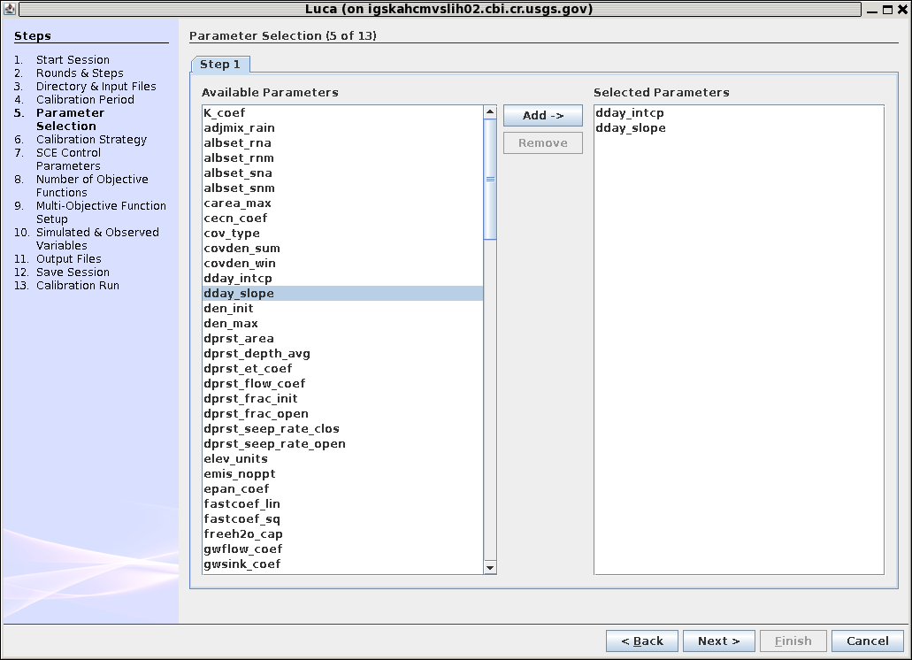
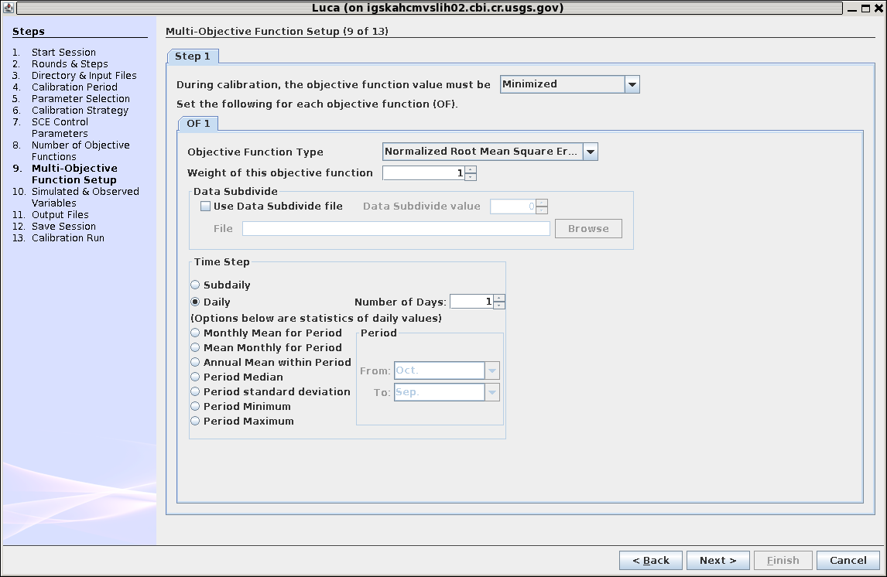
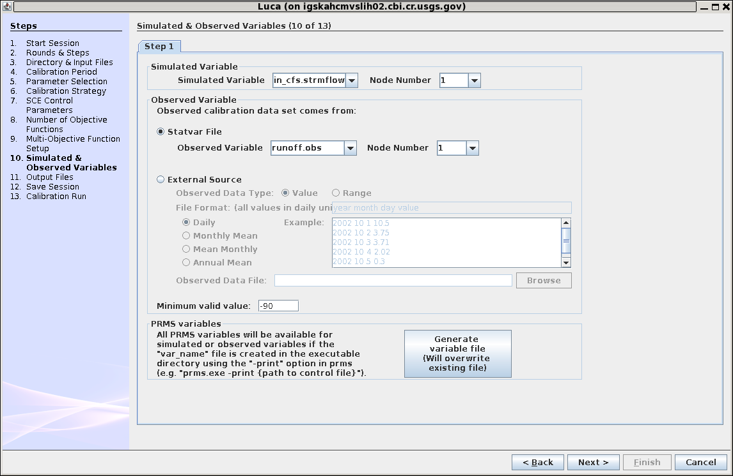
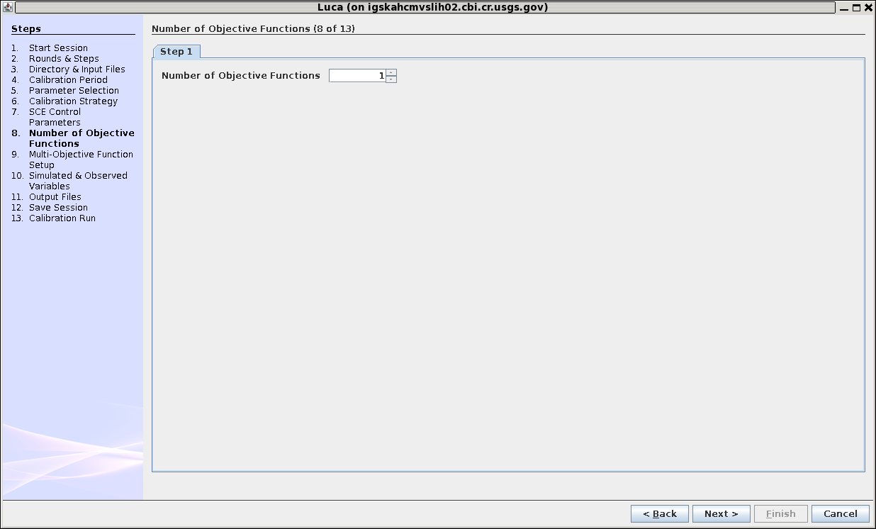
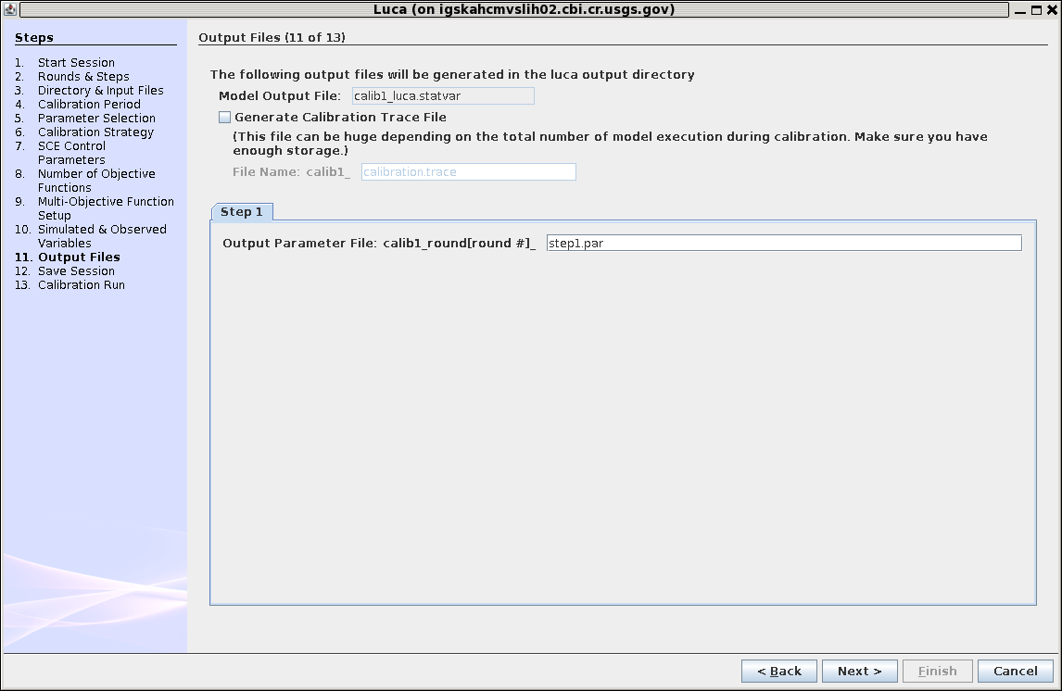
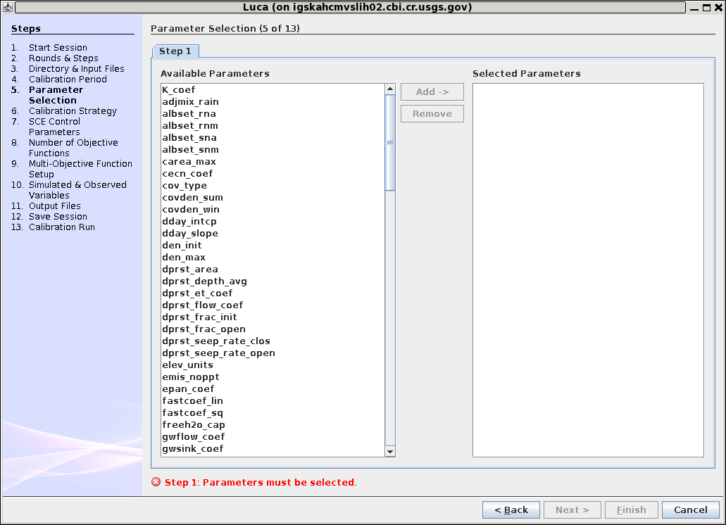
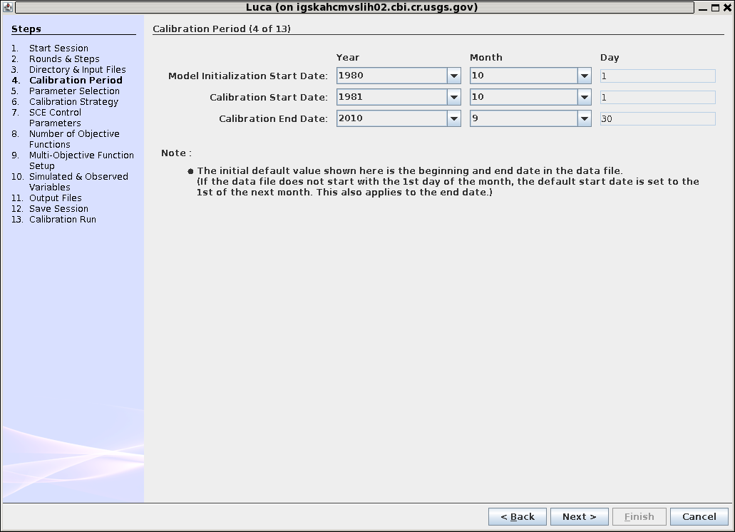

Slide 20
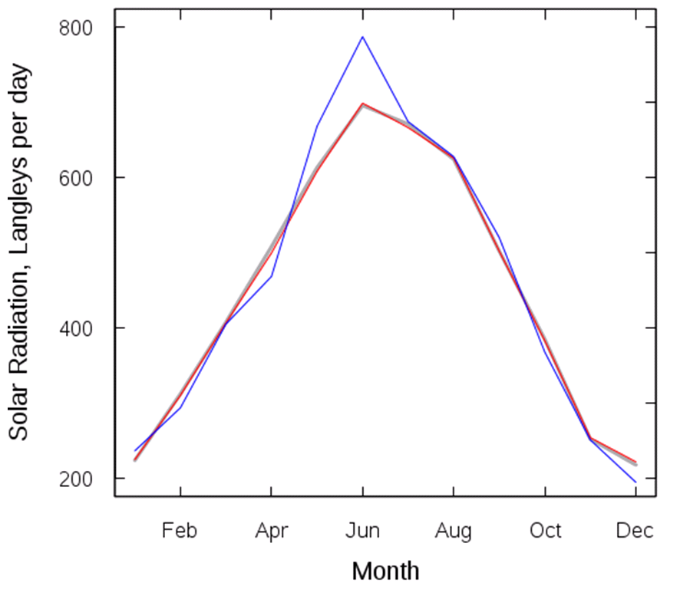
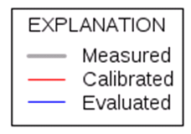
Mean Monthly
Solar Radiation

Slide 21
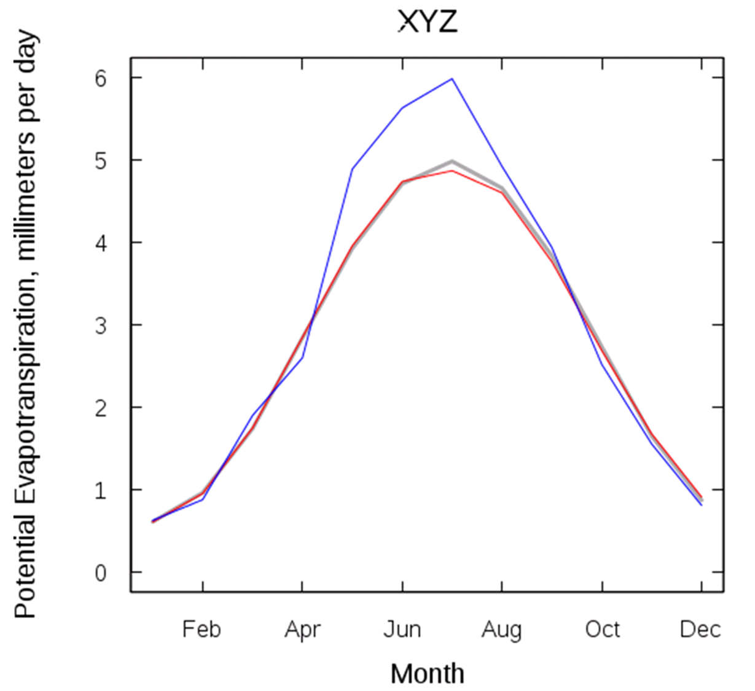
Mean Monthly PET

Slide 22
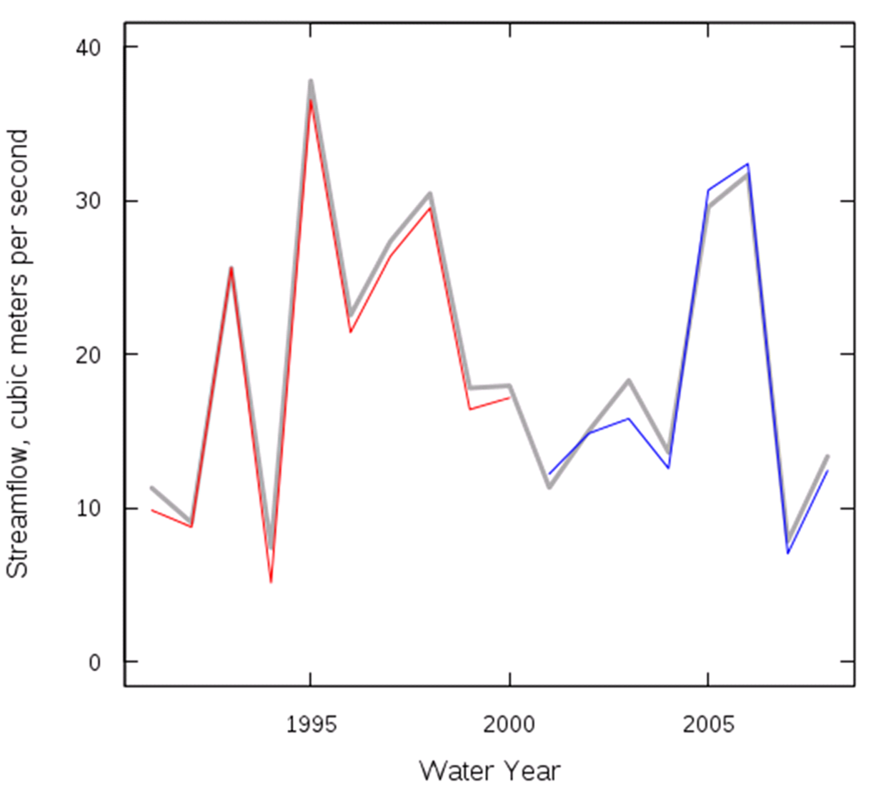
Mean Annual Streamflow

Slide 23
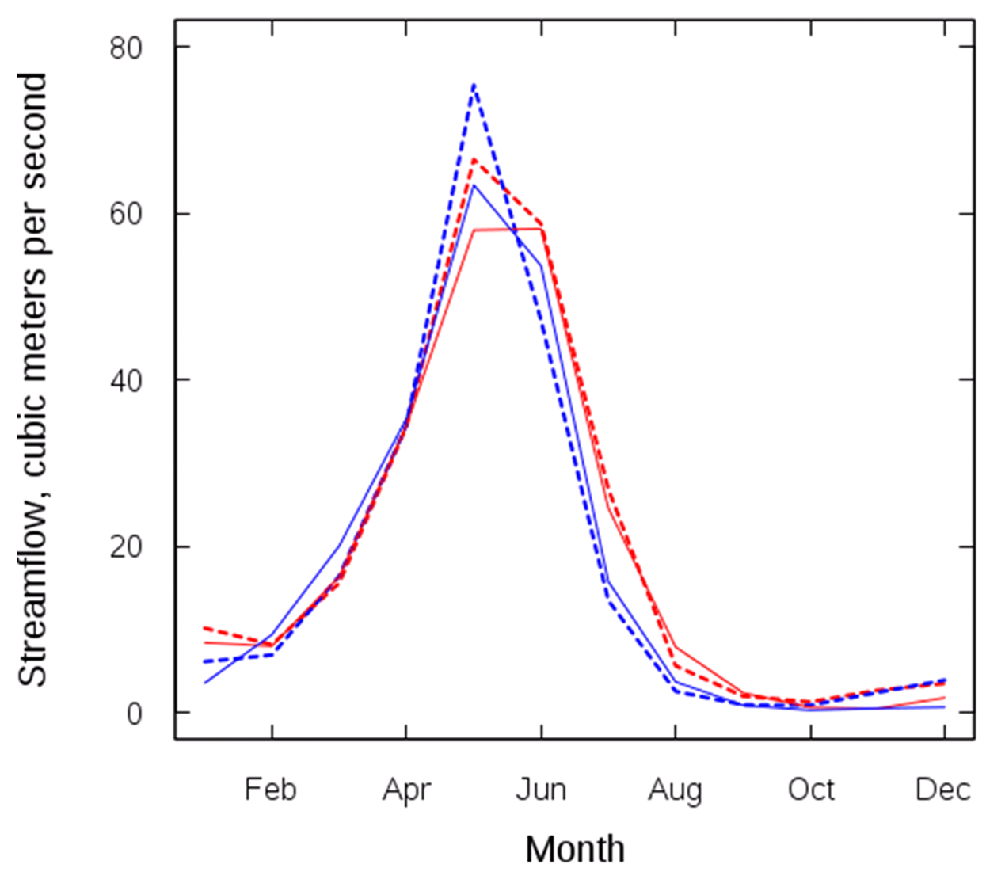
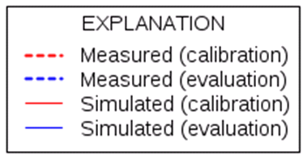
Mean Monthly Streamflow

Slide 24
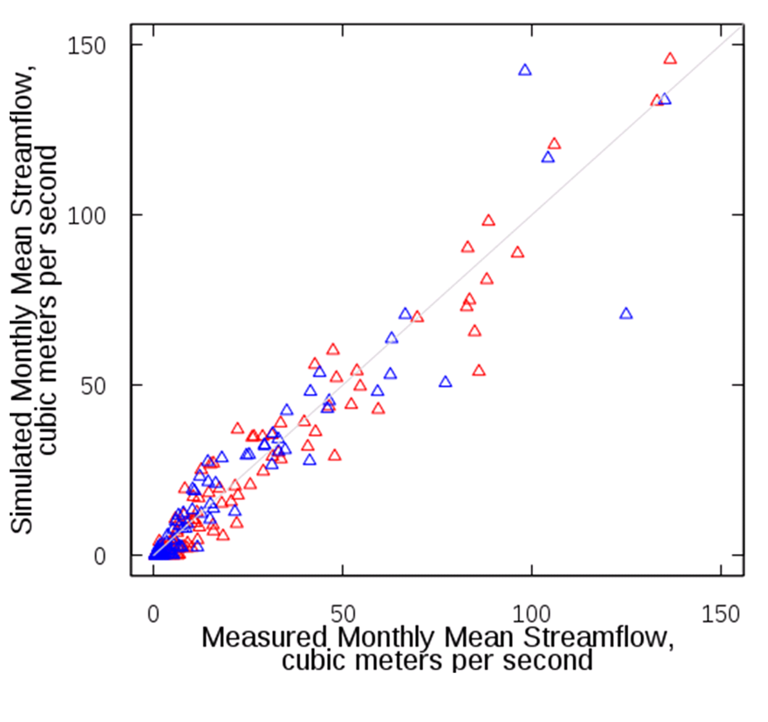
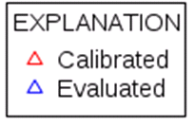
Monthly mean streamflow

Slide 25
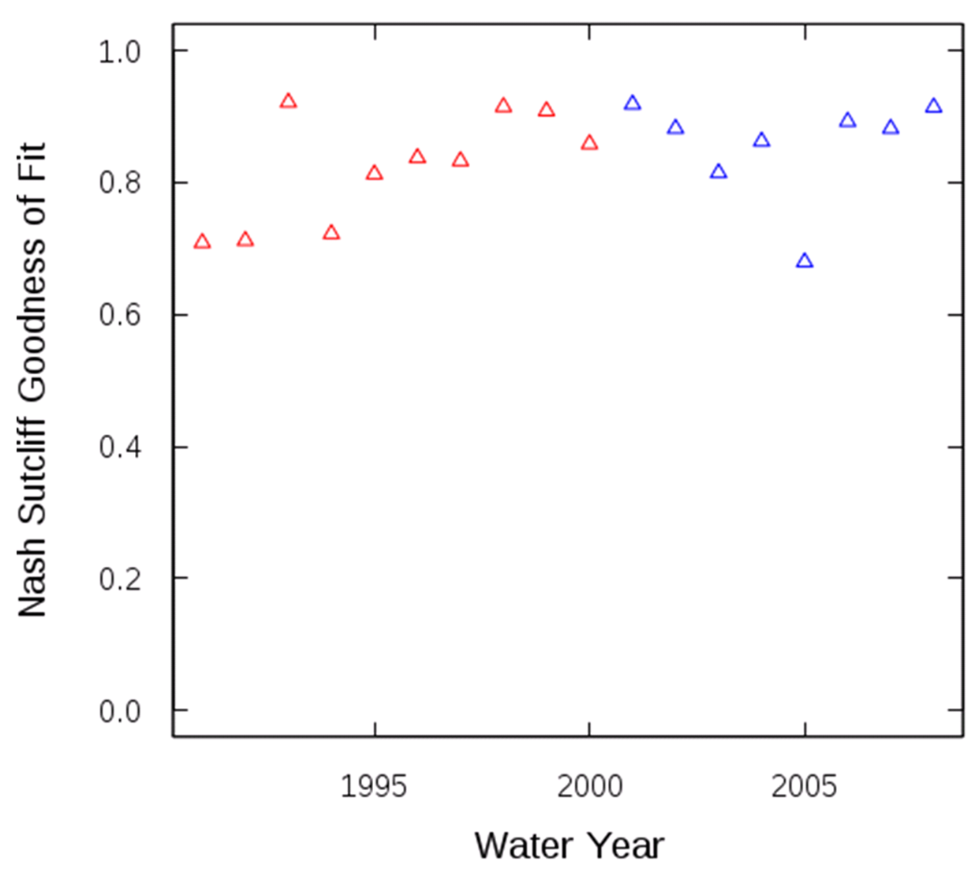
Annual Nash-Sutcliffe

Slide 26
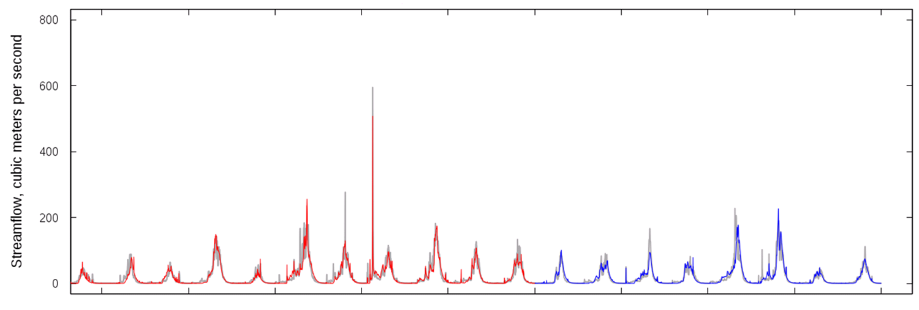

Daily Streamflow

Slide 27
PRMS Calibration with Luca Lauren Hay National Research Program Modeling of Watershed Systems (MoWS) lhay@usgs.gov 303 236 7279

Slide 28
Ordered list of most sensitive PRMS parameters by process and objective function.
These parameters are described by Markstrom et al. (2015, table 1-3).
Process | Objective Function
 | Mean (i.e. total volume) | CV (i.e. “flashiness”) | AR 1 (i.e. day-to-day timing)
baseflow | jh_coef, soil_moist_max, dday_intcp, soil2gw_max, radmax, carea_max, jh_coef_hru | gwflow_coef, soil_moist_max, jh_coef, soil2gw_max, smidx_coef, carea_max, tmax_allsnow, dday_intcp, smidx_exp | gwflow_coef, soil_moist_max, soil2gw_max, carea_max
ET | jh_coef, soil_moist_max, dday_intcp, radmax, jh_coef_hru, smidx_coef, dday_slope | radmax, jh_coef, soil_moist_max, dday_intcp, dday_slope, soil_rechr_max | jh_coef, radmax, dday_slope, soil_moist_max, dday_intcp, soil_rechr_max
runoff | jh_coef, dday_intcp, soil_moist_max, radmax, jh_coef_hru, smidx_coef, dday_slope | gwflow_coef, soil_moist_max, fastcoef_lin, pref_flow_den, carea_max, jh_coef, smidx_exp, smidx_coef, soil2gw_max, tmax_allsnow | slowcoef_sq, soil2gw_max, gwflow_coef, carea_max, soil_moist_max, smidx_exp, smidx_coef, fastcoef_lin, pref_flow_den, jh_coef, slowcoef_lin
infiltration | smidx_exp, soil_moist_max, carea_max, smidx_coef, jh_coef, srain_intcp | carea_max, tmax_allsnow, jh_coef, smidx_exp, srain_intcp, smidx_coef, tmax_allrain, radmax, freeh2o_cap, soil_moist_max, dday_intcp, rad_trncf | carea_max, soil_moist_max, smidx_exp, tmax_allsnow, srain_intcp, tmax_allrain, jh_coef, smidx_coef, freeh2o_cap, dday_intcp
snowmelt | tmax_allsnow, tmax_allrain | tmax_allsnow, tmax_allrain, rad_trncf, freeh2o_cap, dday_intcp | tmax_allsnow, dday_intcp, rad_trncf, radmax, tmax_allrain, jh_coef, freeh2o_cap, cecn_coef, emis_noppt, jh_coef_hru, potet_sublim
soil moisture | soil_moist_max, jh_coef, dday_intcp, radmax | jh_coef, radmax, soil_moist_max, dday_intcp | soil_moist_max, jh_coef, dday_intcp, radmax
direct surface runoff | smidx_exp, carea_max, soil_moist_max, smidx_coef, jh_coef, dday_intcp | carea_max, smidx_exp, jh_coef, tmax_allsnow, smidx_coef, srain_intcp, soil_moist_max, tmax_allrain | soil_moist_max, carea_max, jh_coef, smidx_exp, smidx_coef, tmax_allsnow, dday_intcp, srain_intcp, tmax_allrain, radmax
interflow | soil_moist_max, soil2gw_max, pref_flow_den, jh_coef, carea_max, smidx_exp, dday_intcp, smidx_coef | fastcoef_lin, soil_moist_max, pref_flow_den, jh_coef, carea_max, soil2gw_max, smidx_exp, tmax_allsnow, dday_intcp | soil_moist_max, fastcoef_lin, slowcoef_sq, carea_max, jh_coef, pref_flow_den, smidx_exp, ssr2gw_exp, soil2gw_max, dday_intcp, tmax_allsnow
Parameters not sensitive
adjmix_rain, fastcoef_sq, ppt_rad_adj, radj_sppt, radj_wppt, sat_threshold, ssr2gw_rate, tmax_index, transp_tmax, wrain_intcp

Slide 29
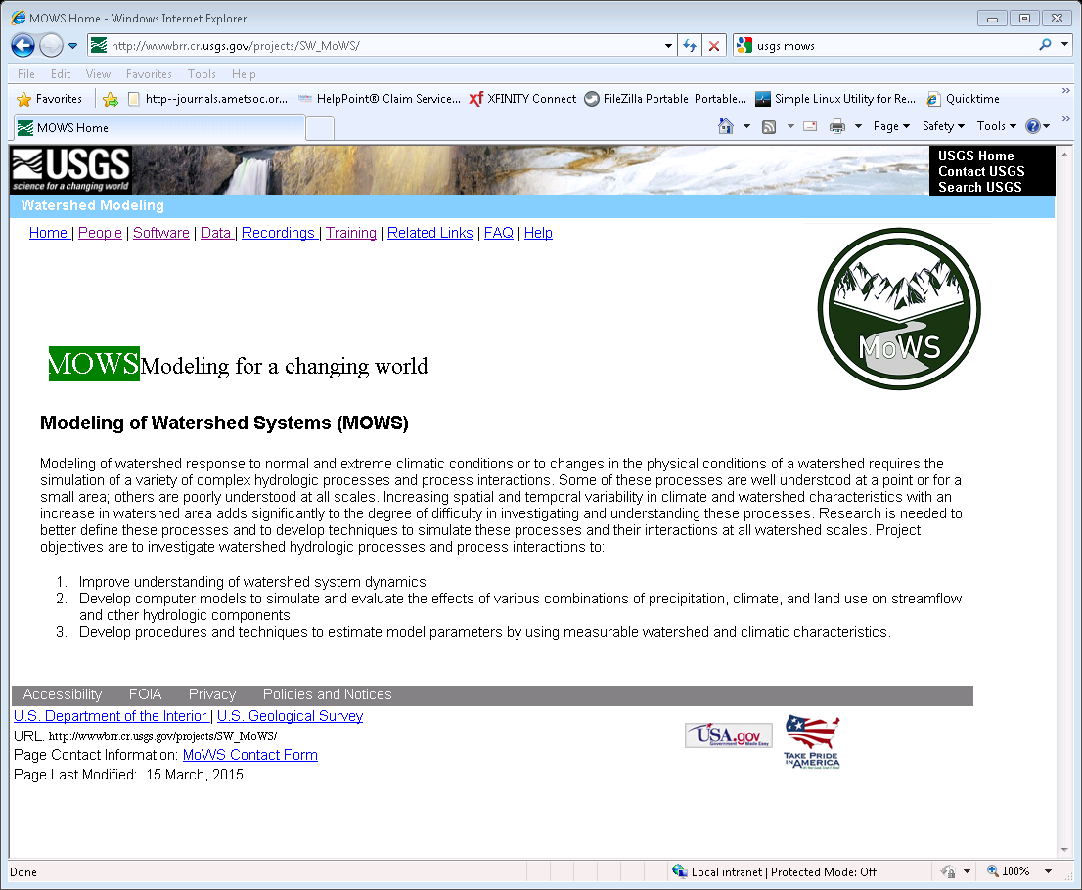
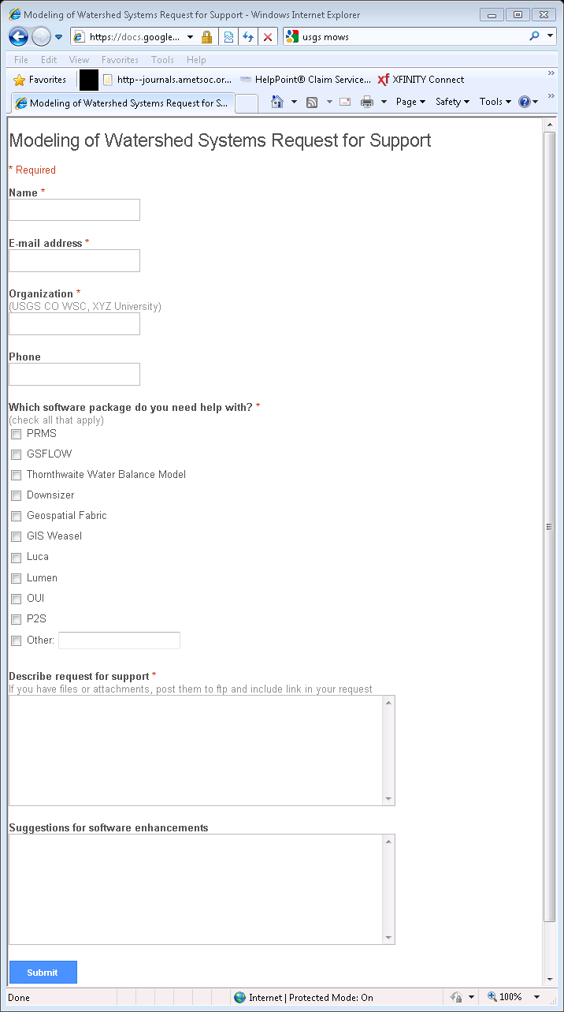
Current Status
Form fill out

